Slide 1
GPS Dilemma
UOIT IEC Group 1
[ariLotter, anthonyDeSouza, lysisMejias, joshuaPineda]

Slide 2

problem_description
create an autopilot program for GPS navigation in 2D

Slide 3

program function
Input
time that signal is received by plane
coordinates of destination point
amount of signal sources available
for each signal source:
heading of signal source
time signal source sends signal
satellite coordinates at initial time t = 0
Output
compass heading from the receiving location to the destination, in degrees
where many locations are consistent with the signals -> inconclusive
no possible locations consistent with the signal -> inconsistent”.

Slide 4

our algorithm
text

Slide 5

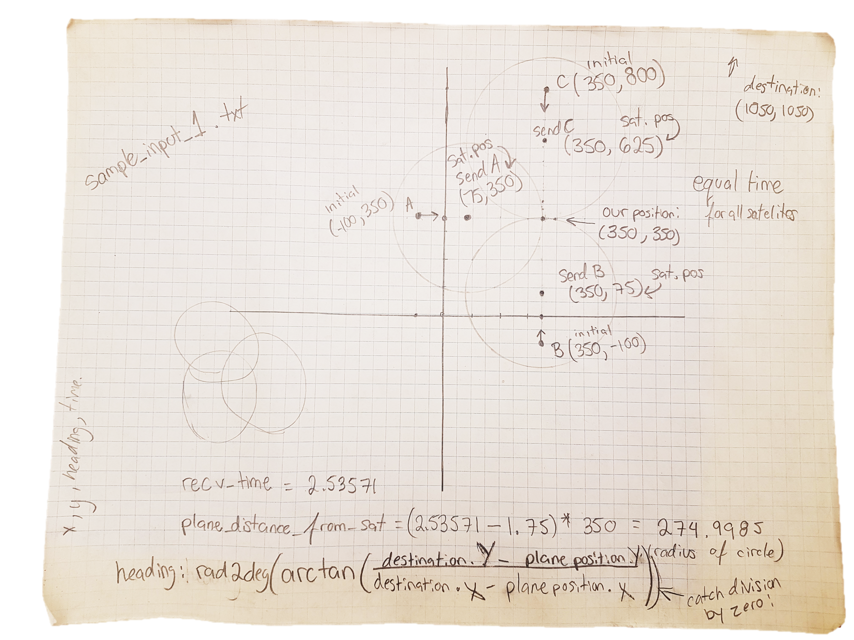

preliminary analysis

Slide 6
visualizing program output
text

Slide 7
designing the GUI

Slide 8

optimizing the process
text

